Slide 1



MEAN Full Stack
Amir Hussain
Cyber security trainer
&
Full Stack Developer

Slide 2
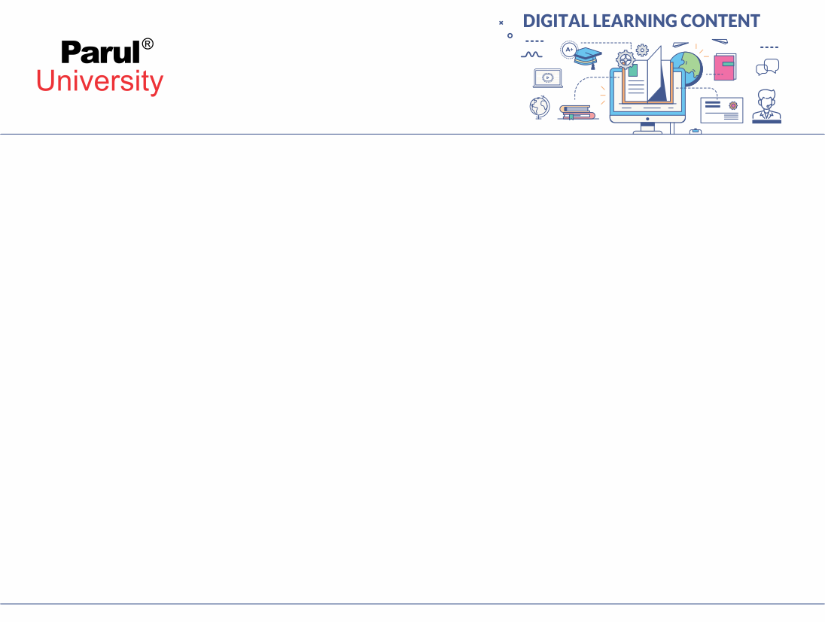

CHAPTER-1
Introduction

Slide 3
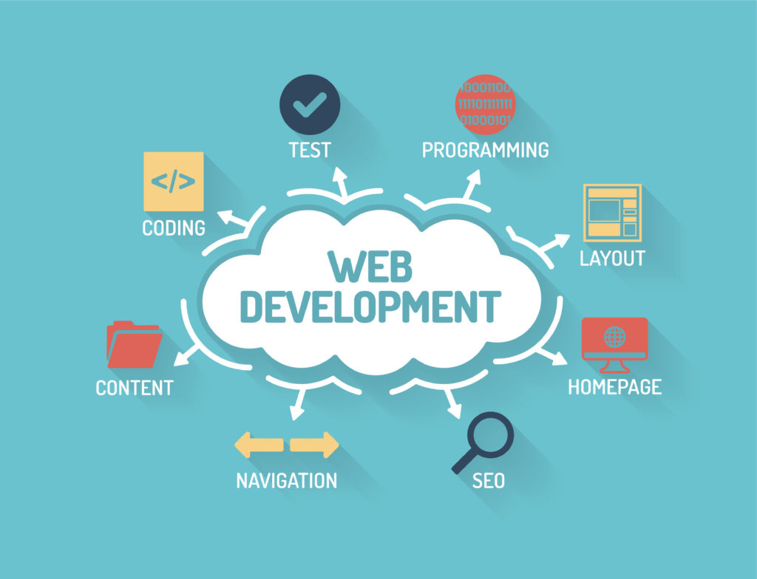
Definition
The word Web Development is made up of two words:
Web: It refers to websites, web pages or anything that works over the internet.
Development: Building the application from scratch.

Slide 4
What is Web Development?
Web development refers to the building, creating, and maintaining of websites. It includes aspects such as web design, web publishing, web programming, and database management.
It is the creation of an application that works over the internet i.e. websites.
The term development is usually reserved for the actual construction of these things (that is to say, the programming of sites). The basic tools involved are programming languages called HTML (Hypertext Markup Language), CSS (Cascading Style Sheets), and JavaScript.

Slide 5
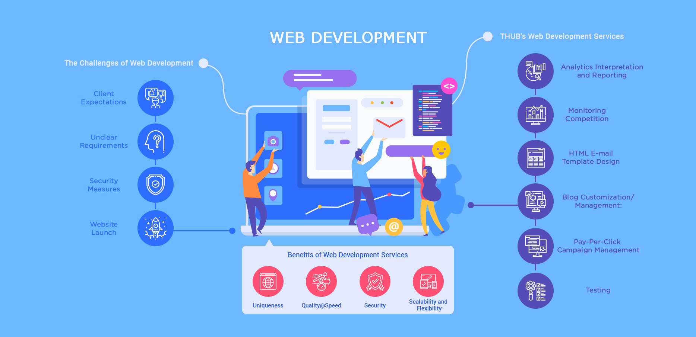

Slide 6
Classification
Web Development can be classified into two ways:
Frontend Development: The part of a website that the user interacts directly is termed as front end. It is also referred to as the ‘client side’ of the application.
Backend Development: Backend is the server side of a website. It is the part of the website that users cannot see and interact. It is the portion of software that does not come in direct contact with the users. It is used to store and arrange data.

Slide 7
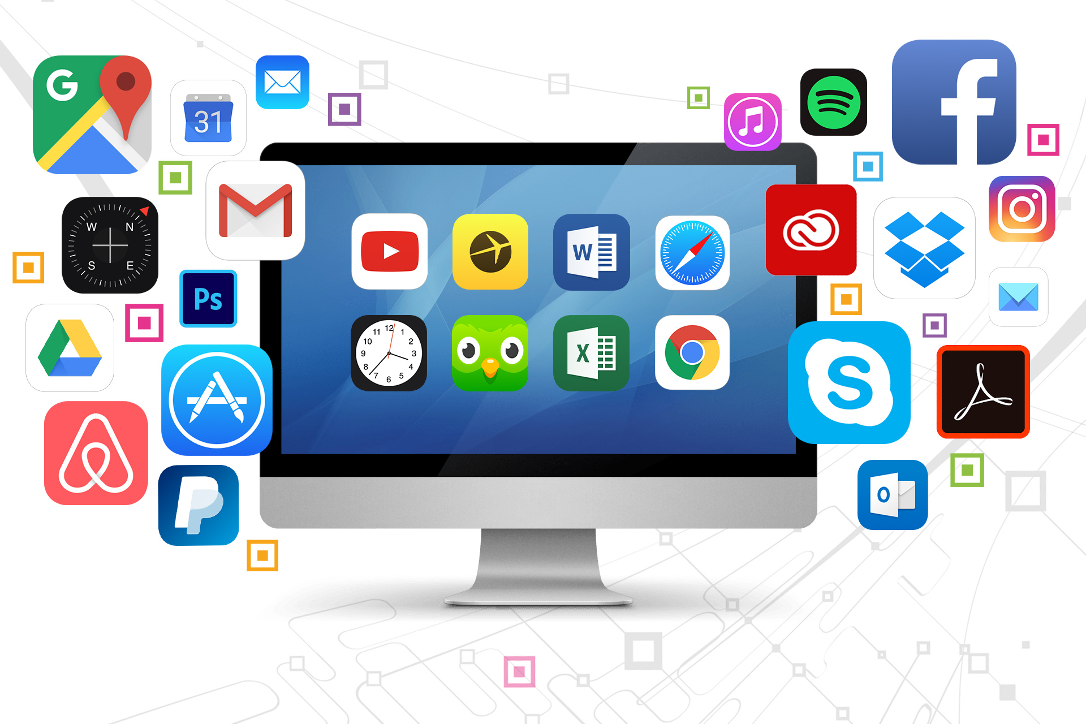
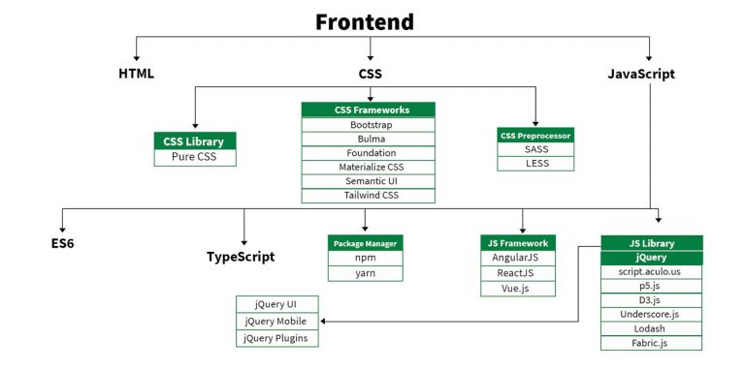
Frontend Roadmap

Slide 8

Frontend Roadmap
HTML: HTML stands for HyperText Markup Language. It is used to design the front end portion of web pages using markup language. It acts as a skeleton for a website since it is used to make the structure of a website.
CSS: Cascading Style Sheets fondly referred to as CSS is a simply designed language intended to simplify the process of making web pages presentable. It is used to style our website.
JavaScript: JavaScript is a scripting language used to provide a dynamic behavior to our website.

Slide 9
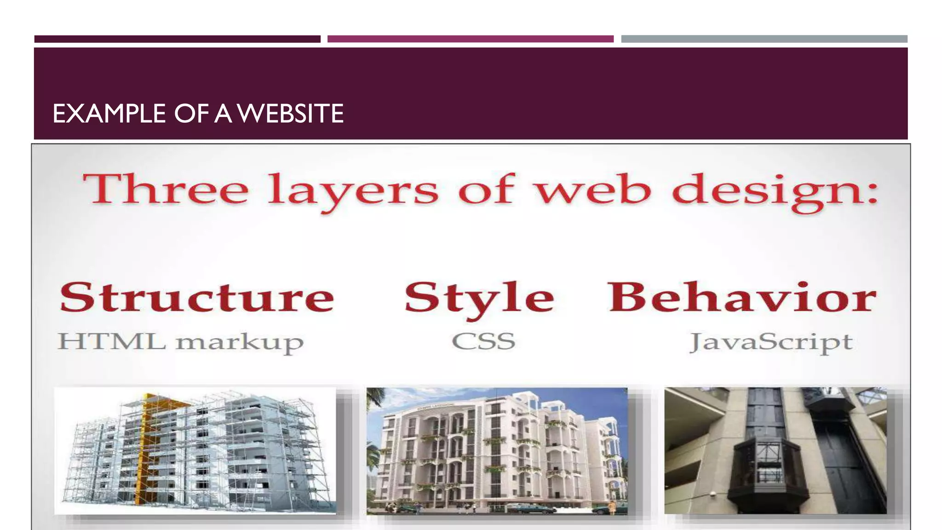
Frontend Roadmap

Slide 10
Frontend Roadmap
Bootstrap: Bootstrap is a free and open-source tool collection for creating responsive websites and web applications.
It is the most popular CSS framework for developing responsive, mobile-first websites. Nowadays, the websites are perfect for all the browsers (IE, Firefox, and Chrome) and for all sizes of screens (Desktop, Tablets, Phablets, and Phones).
Bootstrap 4
Bootstrap 5

Slide 11
Frontend Frameworks and Libraries:
AngularJS
React.js
VueJS
NextJS
Bootstrap
Material UI

Slide 12
Backend Development
Backend Development controls what going on behind the scene of the web application.
Also Known as Server side development.
Backend usually consist three part.
Server
An Application
Database

Slide 13
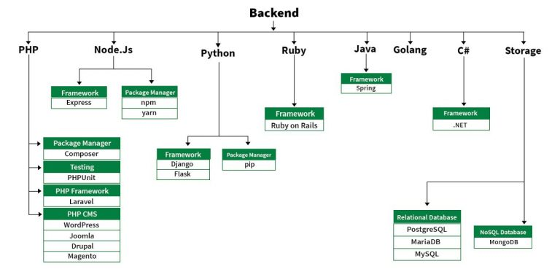
Backend Roadmap

Slide 14
Backend Roadmap
PHP: PHP is a server-side scripting language designed specifically for web development.
Java: Java is one of the most popular and widely used programming language. It is highly scalable.
Python: Python is a programming language that lets you work quickly and integrate systems more efficiently.
Node.js: Node.js is an open source and cross-platform runtime environment for executing JavaScript code outside a browser.

Slide 15
Backend Roadmap
Back End Frameworks
The list of back end frameworks are:
Express,
Django,
NESTJs
Laravel,
Spring, etc.

Slide 16
Databases
No SQL:
MongoDB
BigTable
Redis
Cassandra
HBase
Neo4j
CouchDB
SQL:
MySQL
Oracle
PostgreSQL
Microsoft SQL Server

Slide 17
What is MEAN stack?
The MEAN stack is a JavaScript-based framework for developing web applications. MEAN is named after MongoDB, Express, Angular, and Node, the four key technologies that make up the layers of the stack.
MongoDB — document database
Express(.js) — Node.js web framework
Angular(.js) — a client-side JavaScript framework
Node(.js) — the premier JavaScript web server
There are variations to the MEAN stack such as MERN (replacing Angular.js with React.js) and MEVN (using Vue.js). The MEAN stack is one of the most popular technology concepts for building web applications.

Slide 18
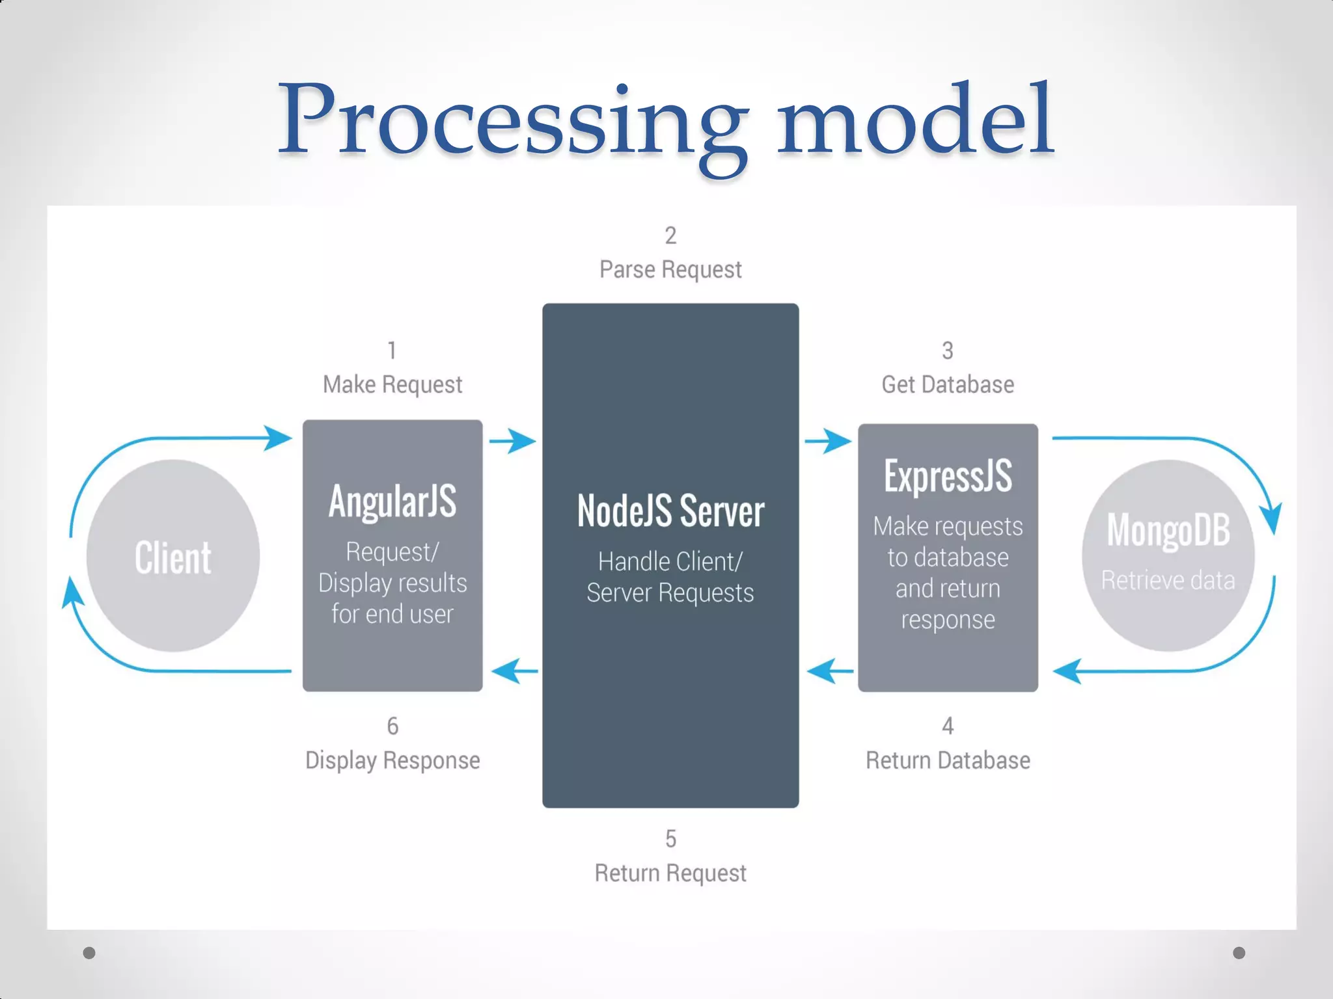
What is MEAN stack?

Slide 19
Rquirements?
Customer wants fast website and fast response.
No Page reloads
Mobile responsive
Etc.

Slide 20
Angular
Angular.js front end
At the very top of the MEAN stack is Angular.js, the self-styled “JavaScript MVW Framework” (MVW stands for “Model View and Whatever”).
Angular.js allows you to extend your HTML tags with metadata in order to create dynamic, interactive web experiences much more powerfully than, say, building them yourself with static HTML and JavaScript (or jQuery).
Angular has all of the bells and whistles you’d expect from a front-end JavaScript framework, including form validation, localization, and communication with your back-end service.

Slide 21
Express and NodeJs
The next level down is Express.js, running on a Node.js server.
Express.js calls itself a “fast, unopinionated, minimalist web framework for Node.js,” and that is indeed exactly what it is.
Express.js has powerful models for URL routing (matching an incoming URL with a server function), and handling HTTP requests and responses. By making XML HTTP requests (XHRs), GETs, or POSTs from your Angular.js front end, you can connect to Express.js functions that power your application.
Those functions, in turn, use MongoDB’s Node.js drivers, either via callbacks or using promises, to access and update data in your MongoDB database.

Slide 22
MongoDB
If your application stores any data (user profiles, content, comments, uploads, events, etc.), then you’re going to want a database that’s just as easy to work with as Angular, Express, and Node.
That’s where MongoDB comes in: JSON documents created in your Angular.js front end can be sent to the Express.js server, where they can be processed and (assuming they’re valid) stored directly in MongoDB for later retrieval.

Slide 23
Setting up the environment
1. Install nodejs version(20.10.0) from https://nodejs.org/en and also visual code studio.
2. Open powershell (with internet connected)
3. Run: Set-ExecutionPolicy -ExecutionPolicy RemoteSigned -Scope CurrentUser
4. Run: node --version
5. Run: npm -g install @angular/cli
6. Run: ng version
7. Open: visual code studio(create new folder) run following commands in visual code new>terminal
8. Run: ng new Yourfirstappname (it will take some time). then choose CSS(press enter)>SSR permission(y).
9. Run:cd ./Yourfirstappname
10. Run:ng serve
11.Open link created in your browser.

Slide 24
Conclusion
In today's Web development, a good page design is essential. A bad design will lead to the loss of visitors and that can lead to a loss of business. In general, a good page layout has to satisfy the basic elements of a good page design.
This includes color contrast, text organization, font selection, style of a page, page size, graphics used, and consistency. In order to create a well-designed page for a specific audience.

Slide 25


www.paruluniversity.ac.in

